Slide 1
Post-Spring Break Revision
Slide sets are now PPTX (old sets = PPT) - may require more
Slide sets are what you would see in class
Click through items as if in class
Play music examples, especially Listening Guide items (for future tests)
Play the audio (click the icons) to hear me
Entire chapter is covered in a single slide set

Slide 2
Friendly Alert
Instructions for the “Scholarly Article Summary” are now posted on the course web site
Paper due: 3 April 2020

Slide 3
Chapter Nine
“To Stretch Our Ears” : Classical Music Comes of Age

Slide 4
Theodore Thomas (1835-1905)
German Immigrant
Violinist in NYC
Theodore Thomas Orchestra - Summer concerts (1864) - touring in US
To Chicago Symphony (1891) - “I would go to hell if they gave me a permanent orchestra”
“…to make good music popular” - belief in the importance of the orchestra - civic pride (orchestra = cultural emblem) - financial support (beyond ticket sales)

Slide 5
Second New England School
Group of Boston – New York composers
Post-Civil War era (1865-1910+)
Classical / Art Music
European trained (either there or here)
Established modern US art music infrastructure
“Second” NE School – came after the “First” group of NE Psalmody composers (Billings, et al.)

Slide 6
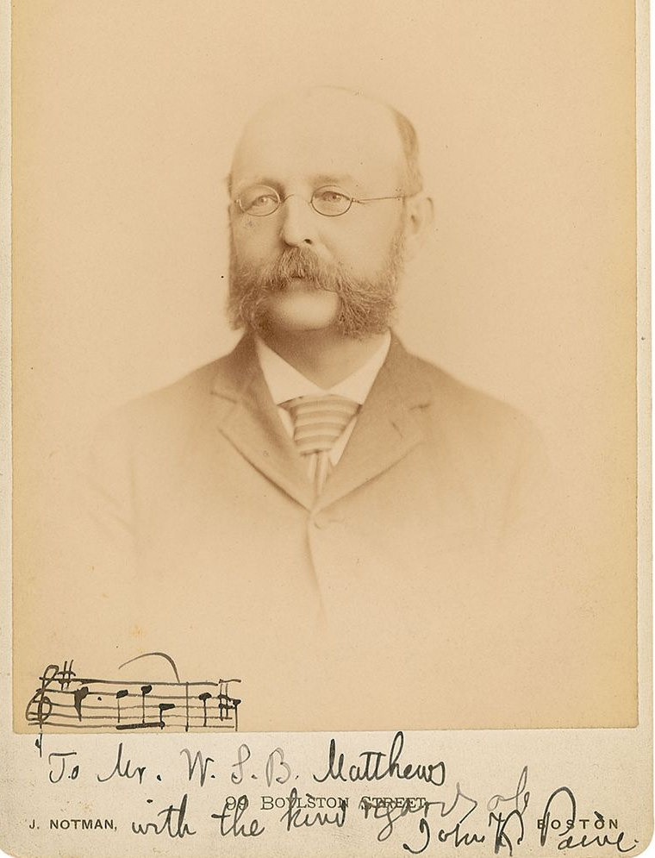
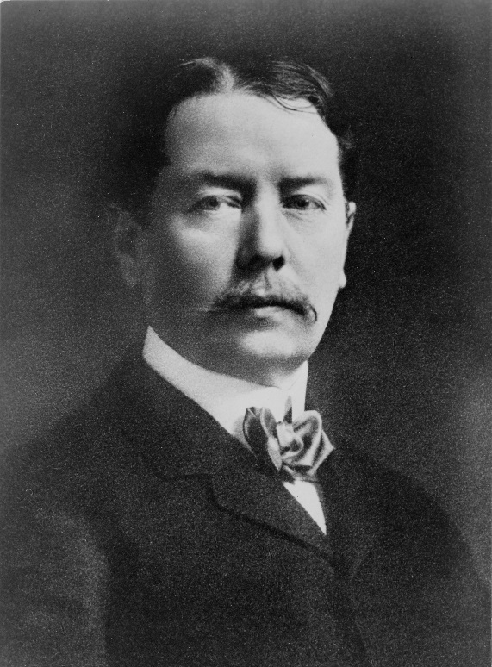
John Knowles Paine (1839-1906)
Musical family (organists in Maine)
Study in Europe (Berlin)
Harvard – 1st Professor of Music in US
Board of New England Conservatory
Widely influential – many colleagues
George Whitfield Chadwick (1854-1931)
Self-taught and “special” NEC student
Study in Leipzig and Munich
Director of New England Cons. (1897-1930)
Influential teacher – H. Parker, W.G. Still, A. Whiting, F. Converse, F. Price, et al.

Slide 7
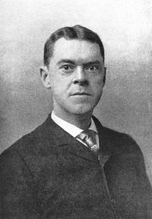
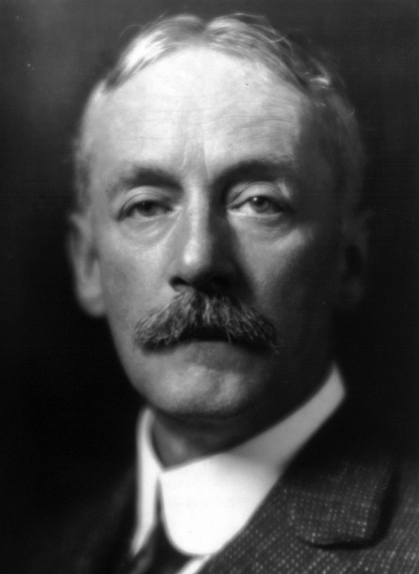
Arthur Foote (1853-1937)
Trained entirely in US (NEC & Harvard) - earned 1st M.A. in Music in US
Organist & founding member of AGO
Teacher & author of theory books
Chamber Music
Horatio Parker (1863-1919)
Student of Chadwick in Boston
Study in Munich w/ Rheinberger
Hora novissima, etc., - makes his rep in 1890s
Theory Professor and Dean of SoM at Yale U
Teacher of Charles Ives

Slide 8
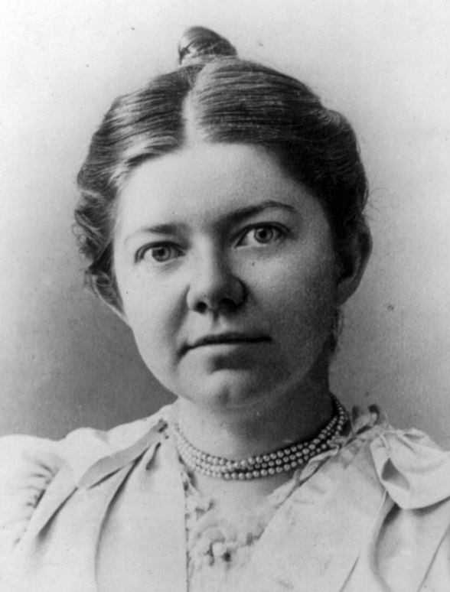
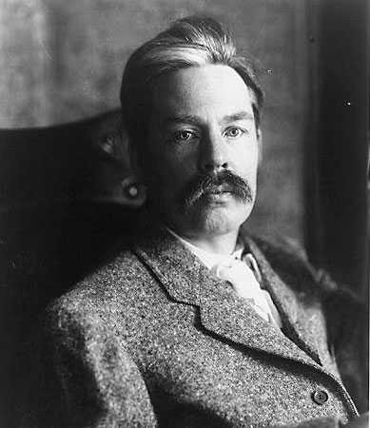
Amy Marcy Cheney (Beach) (1867-1944)
Child prodigy, but family discouraged her
Study in Boston w/ European masters
Self-taught in composition
“Mrs. H.H.A. Beach” (1885-1910)
Leading woman composer (despite prejudices)
Edward MacDowell (1860-1908)
New York born and early music education
Study at Paris Conservatoire, & Frankfurt
Piano teacher in Europe (1881-88)
Returns to Boston, until….
Columbia University (1891-1904)
“New German School” – music as expression

Slide 9
Music Examples
John Knowles Paine - Symphony No.1 in C-minor, Op.23 (1875)
George Chadwick - Rip Van Winkle Overture
Chadwick - Symphonic Sketches: I. Jubilee
Arthur Foote (Scherzo for flute and string quartet)
Horatio Parker - Hora Novissima: Introduction and Chorus
MacDowell - Woodland Sketches, Op. 51: No. 1: To a Wild Rose (LG 9.1)
Amy Beach - Symphony in E Minor, Op. 32, Gaelic: II. Alla Siciliana; Allegro vivace (LG 9.2)

Slide 10
Charles Ives (1874-1954)
George Ives (father) - Civil War Bandmaster - “…to stretch our ears…”
Yale University - Horatio Parker, teacher
Ignored as composer
Ives & Merrick Insurance
Composed for self - often unperformed - numerous revisions
Uniquely AMERICAN composer

Slide 11
Ives – Music Examples
SONGS
Jerry Hadley - The Circus Band - Charles Ives
The Housatonic at Stockbridge
The Things Our Fathers Loved (LG 9.3)
INSTRUMENTAL
Ives: Variations on "America" (1891)
Charles Ives - Symphony No. 2 (Houston Sym Note)
Ives: "The Unanswered Question"
Charles Ives - Piano Sonata No. 2 "Concord"
Charles Ives - Decoration Day (1912)

